Slide 1
Resilience As a Key to Recovery & Health
Doug Tieman
CEO Emeritus, Caron Treatment Centers

Slide 2
Why Me?

Slide 3
Resilience
What is it?
Why is it important?
How do I know if I have it?
How to get it/keep it/grow it?

Slide 4
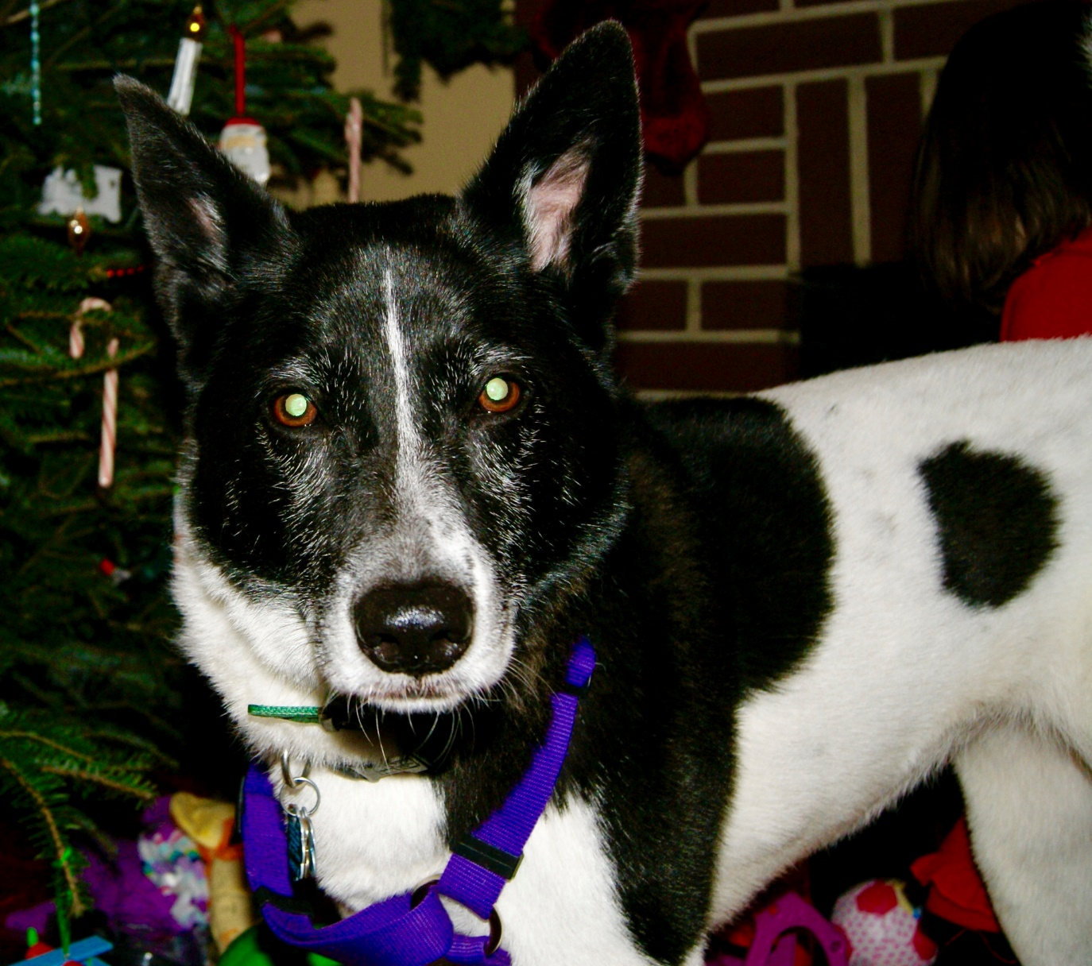
Dog Story

Slide 5
Chinese Proverb
Good luck/Bad luck
Who is to say?
Substance Use Disorder
Bad luck/Good luck

Slide 6
The 5 C’s & Recovery
Confidence
Community
Commitment
Compassion
Centering

Slide 7
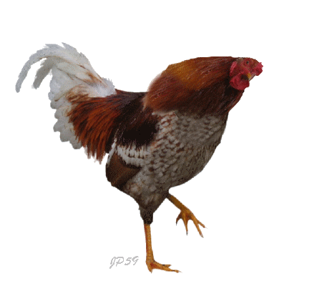
The Chicken Story: 5 Lessons
Responsibility
Ask for help
Develop a plan
Change behavior
Get more than you bargained for

Slide 8
The Take Aways
A personal perspective
What to remember
Serenity Prayer & Promises

