Slide 1
SUD & Recovery: Resilience
Dr. Martha Thompson

Slide 2
Resilience
1: the capability of a strained body to recover its size and shape after deformation caused especially by compressive stress
2: an ability to recover from or adjust easily to misfortune or change

Slide 3
Life is Hard. Scott Peck
Resilience is the ability to bounce back from adversity and perhaps even become happier, smarter, stronger, and healthier than you were before.
How individuals respond to those setbacks can be the difference between stagnation or moving forward.
Resilience comprises a variety of skills and knowledge that can improve individuals improve the quality of their lives when used with practice and persistence.

Slide 4
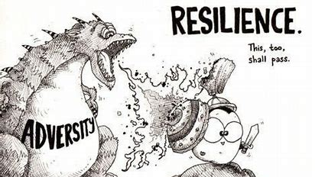

Slide 5
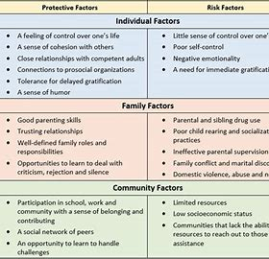

Slide 6
APA
Resilience is the process and outcome of successfully adapting to difficult or challenging life experiences, especially through mental, emotional, and behavioral flexibility and adjustment to external and internal demands.
Many factors contribute to how well people adapt to adversities, predominant among them: the ways in which individuals view and engage with the world the availability and quality of social resources specific coping strategies
Psychological research demonstrates that the resources and skills associated with more positive adaptation (i.e., greater resilience) can be cultivated and practiced.

Slide 7
Why some make it, and some don’t?
Factors that impact resilience
Hope vs Hopeless
Defeat vs Challenge
Other contextual factors i.e. environment

Slide 8
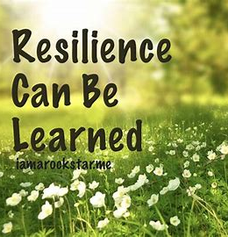
Fostering Resilience
Relationships – connections!
Foster wellness – physical, mental, spiritual
Find purpose – goals!
Embrace healthy thoughts!
Seek Help!

Slide 9
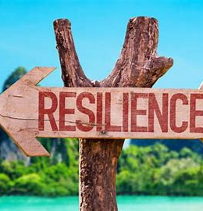
Surviving Burnout (us and our clients)
Our work is hard.
We ask our clients to do hard work too!
Burnout quiz…….

Slide 10
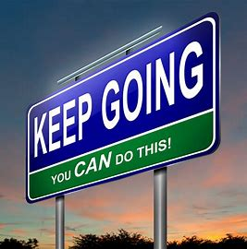
Thank you ☺
Dr. Martha Thompson
drmartha@empowerthemind.org
717-304-2631
Have a great rest of your week!

